Slide 1

Academic Controversy

Slide 2
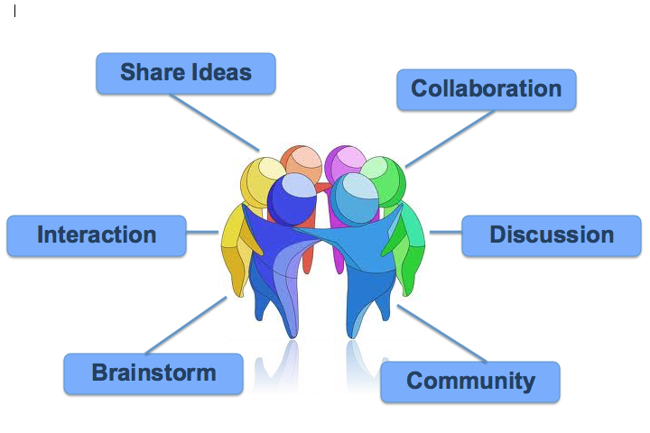
Academic Aim
To create an awareness of Instructional leadership strategies that can be incorporated into the classroom.
Collaborative Task:
  Equal Participation,
  Allocation of groups,
  Engage with content
Notes:
Research has shown that teacher structured groups are the most effective in group work. The other two group structures are less effective and can cause group-work to become a difficult task for maintaining classroom management.
Group Structures
Teacher Structured group (best structure)
Random ( not as effective)
Friendship (worst-avoid at all times)
Directions for the Presentation
Why use IL?
Aims of TGT
Outline objectives of TGT
List of instructional methods used in TGT
Give rules to TGT
Play game
Evaluation of lesson

Slide 3
Effective Group Work
Academic Controversy
Jigsaw

Slide 4
As an Instructional Procedure
The student actively engages and develops a deep understanding of the topic
Cooperative Learning
Intellectual Conflict
Problem Solving
Reasoned Judgement

Slide 5
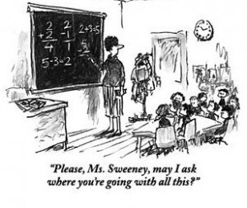
Academic Controversy Aims and Benefits
Allows for individual accountability
Encourages students to accept and extend the ideas of others
Fosters disagreeing in agreeable way
Promotes active listening
These relate to the keyskills on the Framework in both Senior & Junior Cycle
Notes:
Johnstons 5 Basic Elements of effective group work
Well it has academic benefits for the students, it also promotes many of the key skills set in the Framework for the Junior Cycle.
Such as
Managing myself
Managing information and thinking
Being creative
Working with others
Communicating
Being literate
Being numerate depending on content.
Five skills for Senior Cycle as set out by the NCCA
1.Communicating
2. Being personally effective
3. Working with others
4. Critical and creative thinking
5. Information processing

Slide 6


Academic Controversy- Objectives
Academic achievement
Motivation
Peer tutoring
Real life application
Notes:
Motivation:
TGT can be a excellent way to motivate students but again it will highly depend on the small complex structured groups. It is inevitable that competition establishes itself within the class as students play against each other.
Motivation: Intrinsic (Student wanting to do well) V Extrinsic (A prize for getting the best score)
In IL a prize should never be for the benefit of an individual, it should be for the class, or at the very least the group is rewarded as recognition of their effort.
Peer-Tutoring:
As the game processes and the fact that students have a partner for the game means students have the opportunity to learn from each other. They are not alone in answering the question they have the support of their partner. This creates a safety for the learner and it eliminates the fear of failure and embarrassment of being unsure or not knowing that can often have a negative ripple effect in a open classroom setting.
Self-efficacy:
This is developing students elf-esteem and creating a “can-do” attitude to their own learning. Students with a high self-efficacy are open to changes and are more willing to investigate the unknown as the fear of failure is greatly reduced.

Slide 7
Description of Academic Controversy
Groups of 4 or 6, divided in half, each half exploring opposite sides of an issue
Students apply social communication, and critical thinking skills as they argue or present their case similar to a debate
One of the most complex cooperative small group structures
Notes:
There are three main group structures
Teacher structured which is the most effective
Random
Friendship→ least productive and not advised
In practice and in literature and Barrie Bennett does say that students whom are on the spectrum perform better. Care needs to be taken when placing these students.

Slide 8

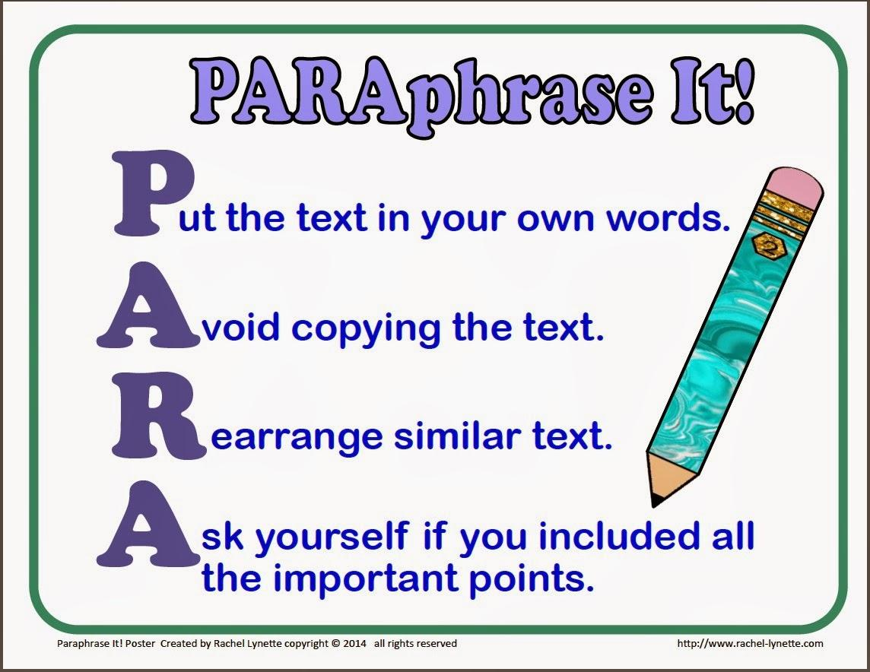
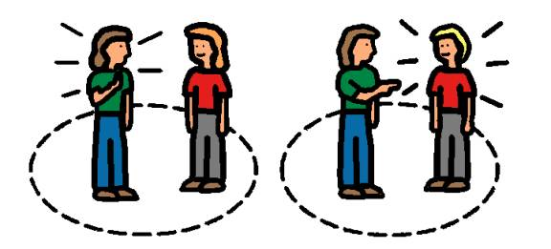



Prior Knowledge Required
Background information related to the topic
Variety of collaborative skills is very important
  Taking turns
  No put-downs
  Suspending judgement
  Active listening
  Paraphrasing
  Disagreeing in an agreeable way
  Accepting & extending ideas of others

Slide 9

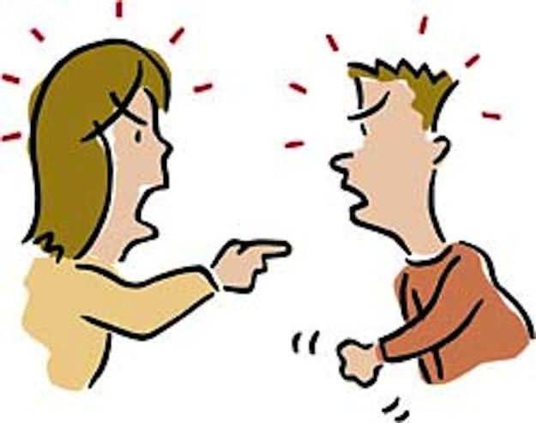
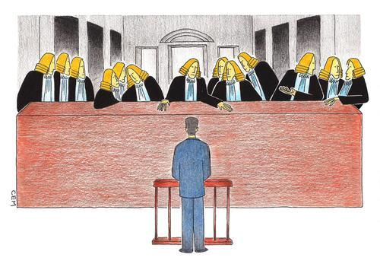





Skills required for Academic Controversy
Taking Turns
No put downs
Suspending
judgement
Actively listening
Paraphrasing
Disagreeing
in an
agreeable Way
Disagreeing
with the idea,
not person
Accepting and
extending the
ideas of others

Slide 10
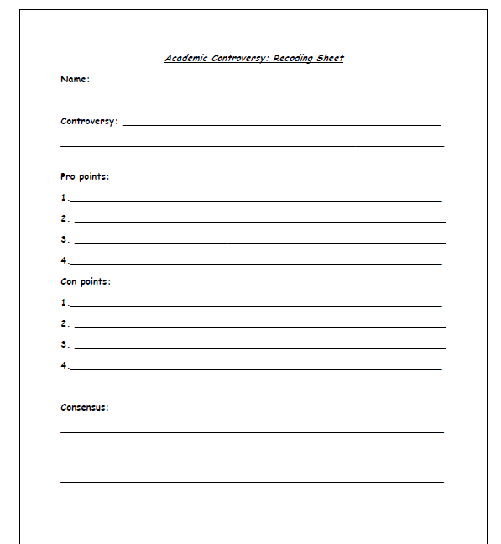
Recording Sheet
A template that allows for planning in the debate
Records key points of argument
Notes consensus’ made

Slide 11
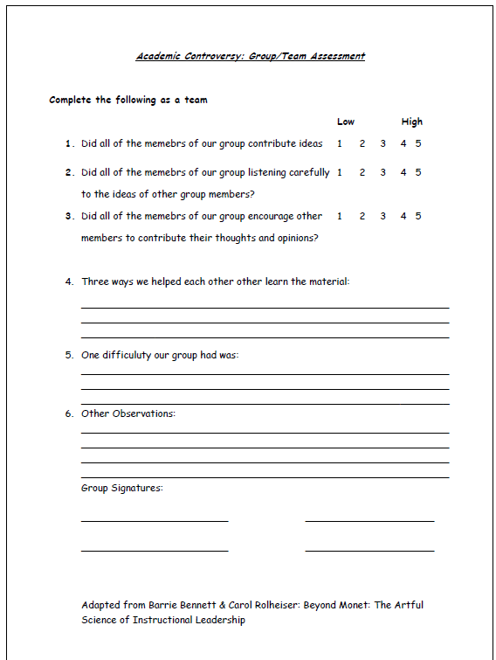
Team Assessment
Formative
Creates accountability
Peer learning
Feedback

Slide 12
Johnsons’ 5 Elements of Effective Group Work
Face to Face Interaction
Individual Accountability
Collaborative Skills
Processing
Positive Interdependence
Notes:
Face to face interaction refers to setting up the group environment so that it encourages students to interact and dialogue with one another. That means they need to be sitting in groups that are approximately 2-4 in size and close enough to one another to hear each others voices and see each others faces.
Individual accountability-refers to ensuring that each member of the responsible for their own learning and willing to encourage and support the learning of others.
Collaborative skills- refers to social communication and critical thinking skills that the students need to work in groups. i,.e. willingness to listening to others, disagree agreeably Critical thinking skills is the ability to analysis, to evaluate and to synthesis.
Processing-refers to reflection and assessing the groups efforts both in terms of their academic and collaborative interaction without it groups do not develop as effectively over time, which negatively impacts social and academic learning.
Positive Interdependence-refers to students working together in supportive ways and being accountable and caring for one another.
Goal: think objective: it must be clear and meaningful and it must be put on a board/overhead so that students who struggle with auditory memory can review it if necessary. This is the one that must always be used. The others are used based on need.
Role: only in the moment
Resources: shared
Incentive: something everyone can win
Outside force: team name
Environmental: forces people to work together, experiment settings needed.
Identity : team name
Sequence : when each student in the group has a task and each must complete in order to finish.
Simulation: Role Play

Slide 13
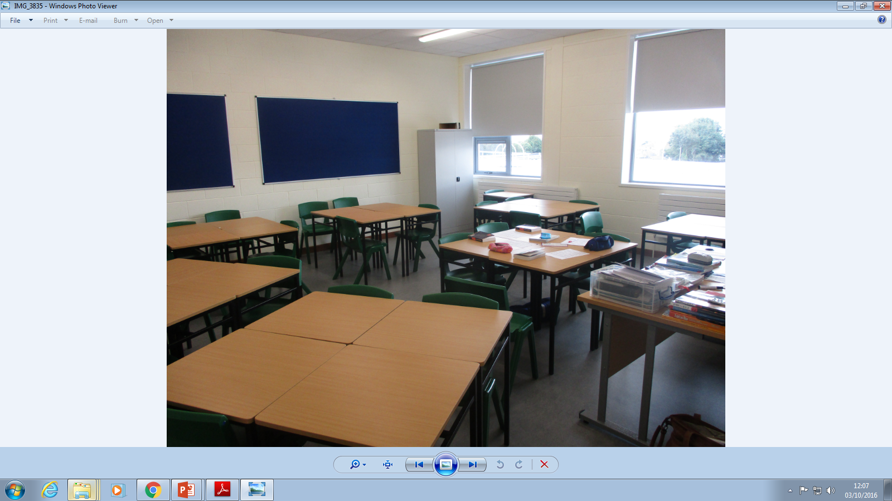
Classroom Considerations
An area suitable for group work
  IL classroom layout
Heterogeneous group
  Mixed ability

Slide 14
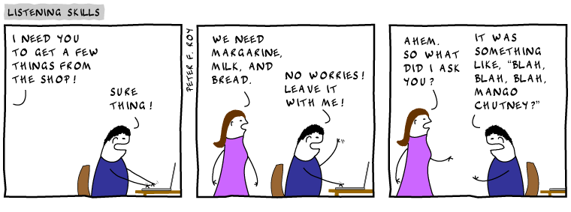
Academic Controversy
Notes:
Blooms Taxonomy is an instructional organiser. It is organised in low-order to higher order thinking questions. The areas of Blooms are Remembering (Recall), Understanding (Comprehension), Applying (Knowledge), Analysis, Evaluating (Application) and Creating (Synthesis). It is important that we use Blooms to maximise the effectiveness of our questions.
Blooms is integral to framing questions
Framing questions: is an instructional Skill. Questions should be used to enhance and check learning. Use questions appropriately to suit the student.
Wait Time is an instructional skill. It is recommended that you give a learner a minimum of 3 seconds.
Think-Pair-Share: Is an instructional tactic. Put a question out there, give students the chance to think about what you asked, then get them to confer with their partner and then inform them that you will select someone to answer. This is important as you are informing them that they all need to have an answer ready if they didn’t know initially.

Slide 15
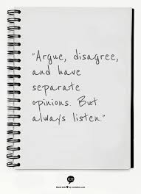
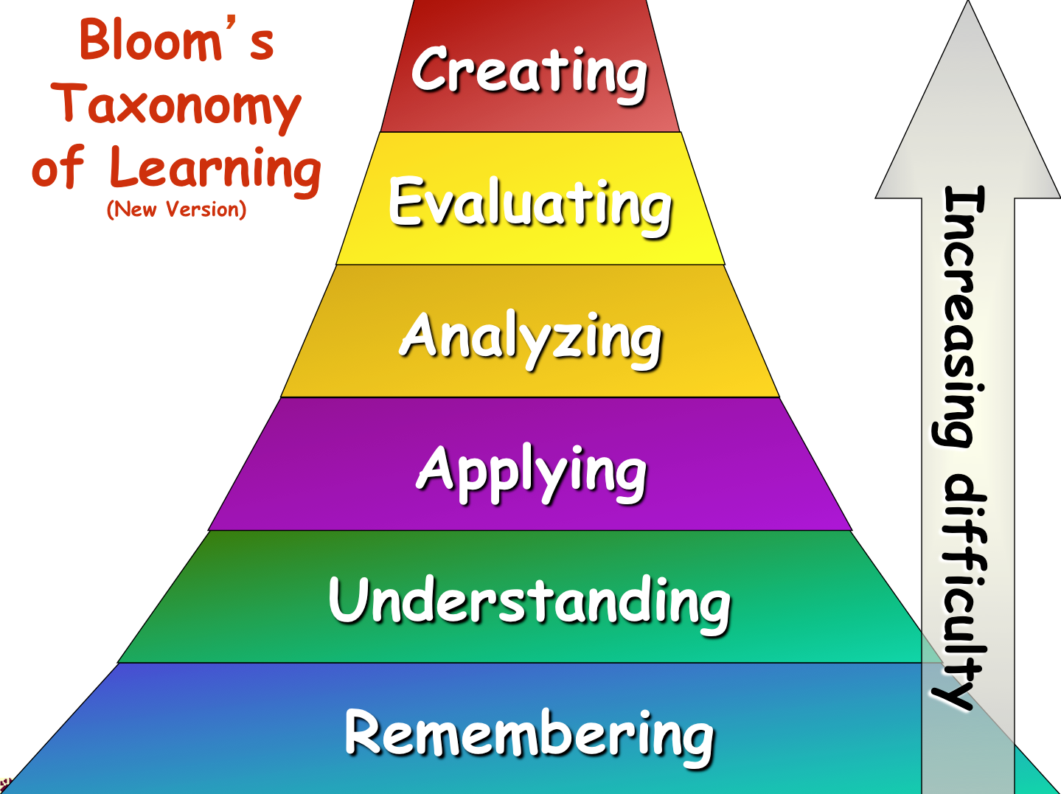
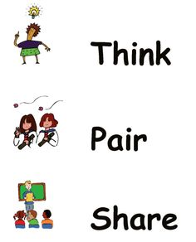

Academic Controversy
Disagree
agreeably
Notes:
Blooms Taxonomy is an instructional organiser. It is organised in low-order to higher order thinking questions. The areas of Blooms are Remembering (Recall), Understanding (Comprehension), Applying (Knowledge), Analysis, Evaluating (Application) and Creating (Synthesis). It is important that we use Blooms to maximise the effectiveness of our questions.
Blooms is integral to framing questions
Framing questions: is an instructional Skill. Questions should be used to enhance and check learning. Use questions appropriately to suit the student.
Wait Time is an instructional skill. It is recommended that you give a learner a minimum of 3 seconds.
Think-Pair-Share: Is an instructional tactic. Put a question out there, give students the chance to think about what you asked, then get them to confer with their partner and then inform them that you will select someone to answer. This is important as you are informing them that they all need to have an answer ready if they didn’t know initially.

Slide 16




Actively listen.
Discussion
Rules
Share the floor.
No disagreeing
until consensus.
Be open minded to the opposing case.

Slide 17
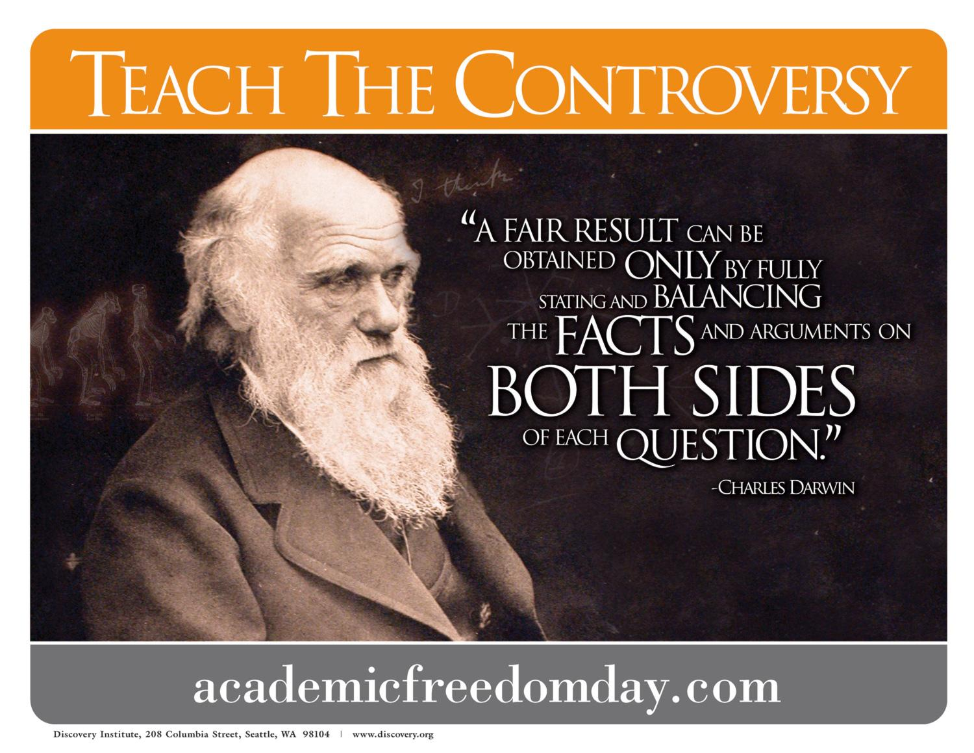

Slide 18

Materials Required for Academic Controversy
Pencil
Recording Sheet
Assessment Sheet

Slide 19
Academic Controversy
Step
1 | Identify the controversy
2 | Divide class into groups of 4 or 6. Each group is then divided in half, one half being “FOR”, one half “AGAINST”.
3 | Letter off students
4 | Each group plans 3 opening points for their stance (1-2 minutes to plan)

Slide 20
Academic Controversy
Step
5 | Each side presents opening points (3 minutes) Listen carefully-(do not respond)
6 | Exchange opening statements with other side and plan disagreements-discuss flaws, focus on the one that you think is their tragic flaw (1-2 minutes)
7 | Presents disagreements agreeably (3 minutes)

Slide 21
Academic Controversy
Step
8 | Change sides-stand up, change seats, argue opposite side of the issue
9 | Repeat steps 4 to 7.
10 | Conduct a Round Robin on your position- discuss individually what your stance is, based on arguments
11 | Attempt consensus-share group’s thinking.

Slide 22
Effective Uses
Use in all subject areas
Use to express thoughts and opinions on a topic
Use to provide structure in group discussions

Slide 23
Extensions/Modifications
Write a compare and contrast essay.
Design a poster supporting one side of the issue.

Slide 24
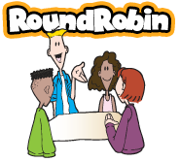
Effective Uses:
To access prior knowledge or to review learning
to encourage the expression of thoughts and opinions on a topic
to provide structure to a group discussion
Key Benefits:
allows each student take a turn
provides structure where only one student is speaking at a time

Slide 25
Jigsaw
Description:
A cooperative activity in which students are part of a cooperative group/team this is called Home Team.
Each member of the home team becomes an expert on a different aspect of one topic of study.

Slide 26
Jigsaw
Prior Knowledge Required:
Active listening
Taking turns
Independent working skills

Slide 27
Jigsaw
Procedures:
Arrange home groups and give each person a letter within the group.
Form expert groups by having all the A’s from each home group come together.
Assign each expert group different material to learn and become experts on.
Students then return to their home groups and take turns sharing their expert knowledge.
The goal is for all home group members to become experts on all materials.

Slide 28
Jigsaw
Classroom Management Considerations
Weaker and stronger students can be paired.
Timing.
Check for understanding before returning to home group.

Slide 29
Jigsaw
Materials:
Material/information on specific topics.
Graphic organisers or paper to record important information.

Slide 30
Effective Group Work
Academic Controversy
Jigsaw

Slide 31
Group Assignment

Slide 32

Will it benefit Ireland?
Table 1

Slide 33


Trump V Clinton
Trump will make a better president?
Table 2

Slide 34
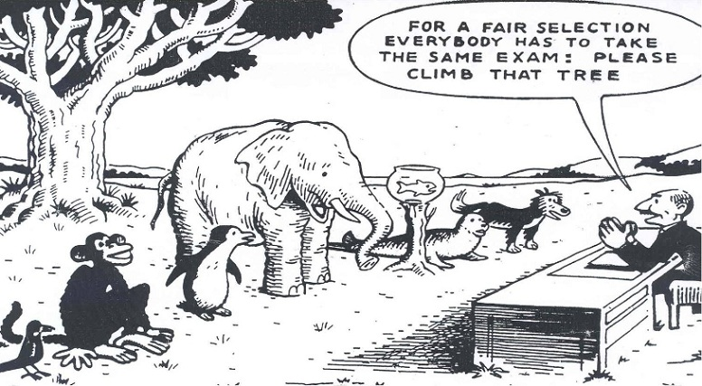
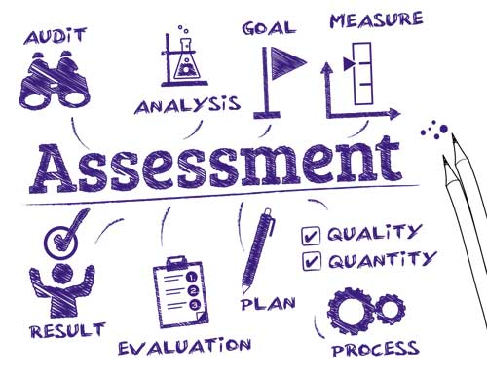
What if you were only given feedback rather than grades for your work?
Changes in assessment are needed?
Table 3

Slide 35
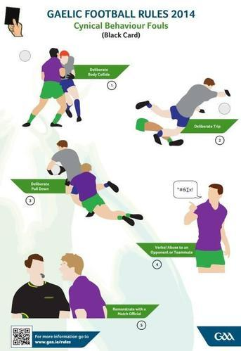
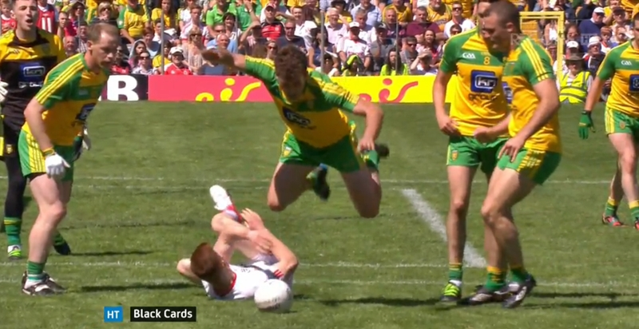
The Black card has improved discipline on the Gaelic football pitch
Table 4

Slide 36
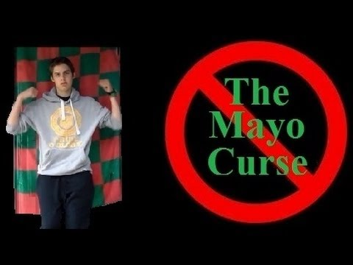

Mayo are truly cursed!!!
Table 5

Slide 37
Instructional leadership has greatly improved teaching & learning.
Table 6

Slide 38
How can Academic Controversy be used in your teaching?
Subject | Example
English | Shylock deserves his final punishment? Friar Lawrence is solely responsible for the demise of Romeo & Juliet.
Agricultural Science | Artificial Insemination (AI) is a serious ethical issue in the agricultural sector. Aboliltion of milk quotas will give many dairy farmers scope to increase milk production for the first time in more than thirty years.
Gaelige | Tá córas oideachais iontach againn in Éirinn. Sa scéal “Hurlamaboc”, is fímineach (hypocrite) í an t-údar.
CSPE | With the ongoing issue regarding obesity in Ireland, the government needs to introduce the sugar tax now?
History | The partition was a good solution to the Irish Crisis between 1912-1923.
Geography | Global warming is not a real concern for our generation.
Maths | In a parallelogram, the diagonals meet at right angles.
Engineering | Advanced manufacturing has made manual skills redundant.
Construction | IKEA has destroyed craftsmanship in furniture making.

