Slide 1



Supporting Principals, Deputy Principals & Middle Management to Lead Teaching & Learning
Mr Joe Boyle and Ms Annette Gildea
Leading Learning; Creating a Culture of Improvement and Collaboration in Teaching, Learning and Assessment.

Slide 2
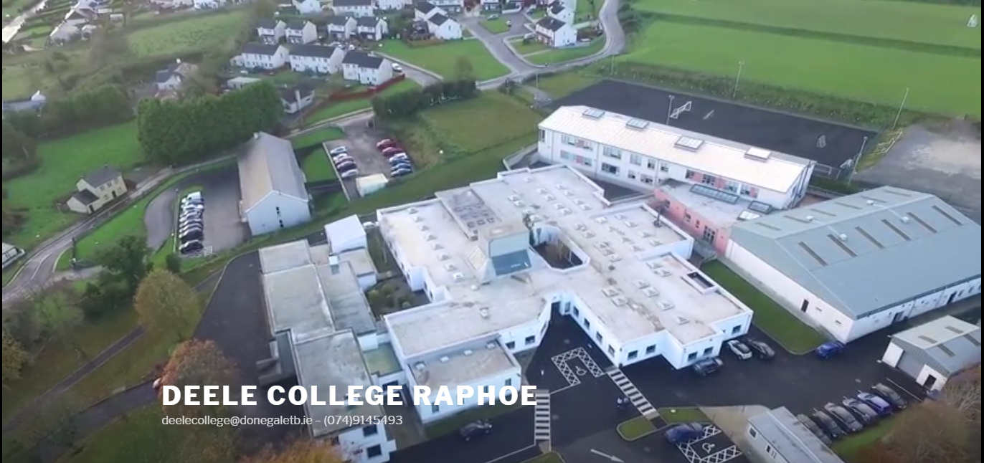
Notes:
Deele College, Raphoe
Established in 1964
A rural (border) ETB co-educational secondary school.
585 students enrolled for August 2018.
50 teachers and 13 SNA’s
DEIS School
Home School Community Liaison (HSCL)
School Completion Programme (SCP)
Behaviour for Learning (BfL)
An ASD class.

Slide 3
Learning Outcomes
Identify a wide variety of learning and teaching methods that may be employed effectively in staff meetings to model best practice of an active classroom.
Identify effective strategies and incorporate them into problem solving timetabling issues.
Apply Instructional Leadership to recap on the key information on four key managerial issues by participating in a Teams Game Tournament.
Work as part of a team in analysing issues in a school context with your peers.
Develop a staff meeting agenda that incorporates Instructional Leadership.
Evaluate what impact Instructional Leadership as a method of engaging teachers in key school issues could have on your staff in September.

Slide 4
Timetable
Introduction - 10 mins
Academic Controversy – 20 mins
Jigsaw – 20 mins
Teams Game Tournament – 20 mins
Planning your Start of Year Staff meeting – 10 mins
Question and Answers – 10 mins

Slide 5




Role and support of the Donegal ETB
Role and Support of Management
Training Staff in IL
Communicating strategies and common IL goals to staff
Future Goals
Cohort 11, continue sharing resources, Teaching, Learning and Assessment Core Team
Continuously promoting IL, setting goals
Cluster meetings and open door policy, shared resources
Principal/Deputy trained in IL, recognised the applications of IL in our school.
School Cluster Workshops

Slide 6

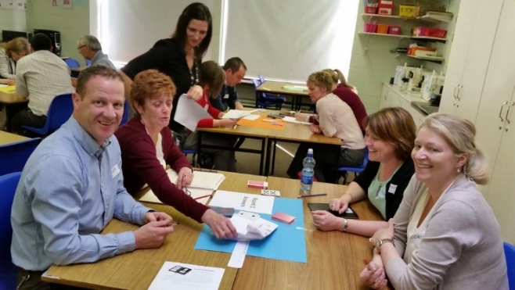
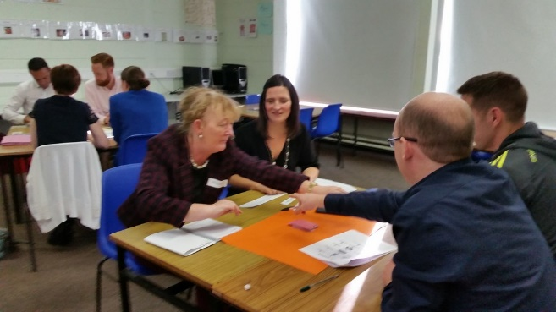
Supported by Donegal ETB
Investment in ETBI IL CPD Programme – Funding – Time
Cluster Meetings – Schools Trained Collaboratively
Incorporated into Subject Department Meetings / Plans
Sharing of Resources – Google Drive – Teacher Collaboration
Resource Sharing through Content Creation Group
Delivered in the classroom

Slide 7

Role of Principal / Deputy Principal / Senior Leadership and Management
Principal Deputy Principal Trained in IL
Staff Meetings
Introduction of New Subject
SSE-Subject Planning
  Making IL Visible In Our School

Slide 8
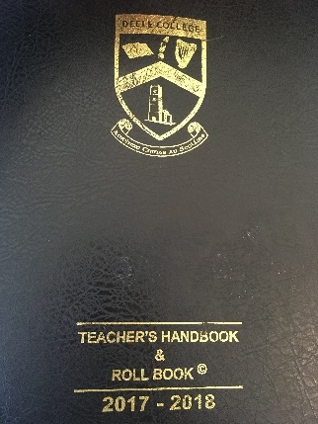
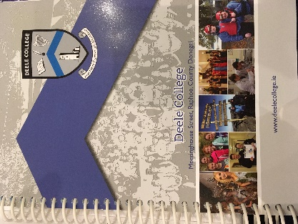
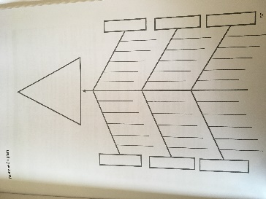
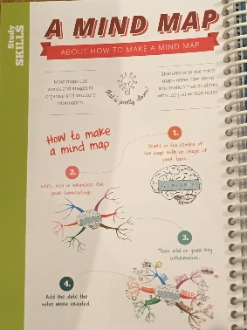
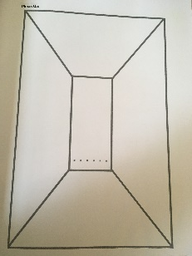

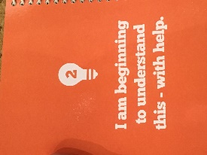

Teaching, Learning and Assessment Core Team
Targets Set
Room Layout
Resource Budget
Team Teaching
Monitor and Feedback
Teacher Diaries
Student Diaries
Shared Resources

Slide 9

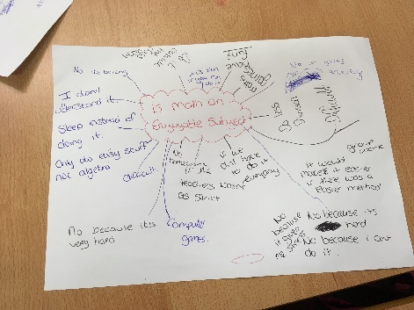
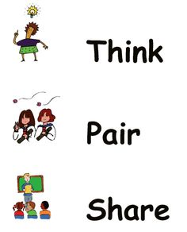
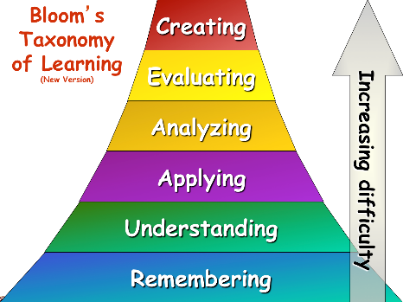
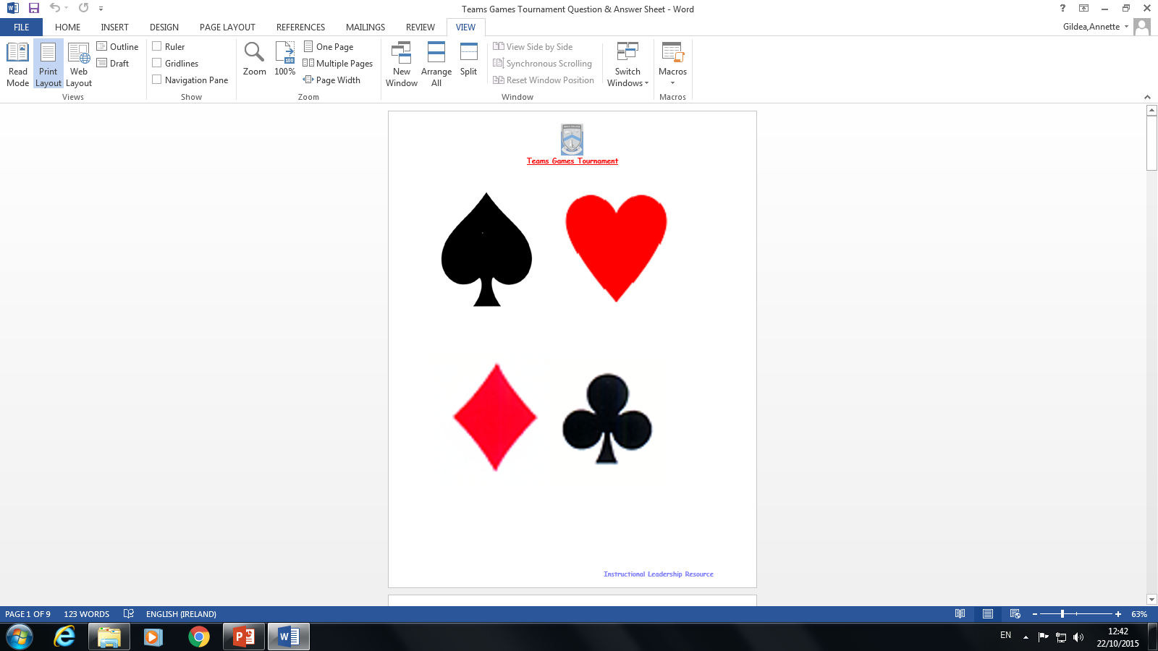

Instructional Leadership Skills, Tactics and Strategies
Jigsaw
Grafitti
Academic controversy
Four corners
Learning To Learn
Placemat
Think-pair-share
Concepts maps
Blooms taxonomy
Effective groupwork
Graphic organisers
Teams Game Tournament
Snowball

Slide 10
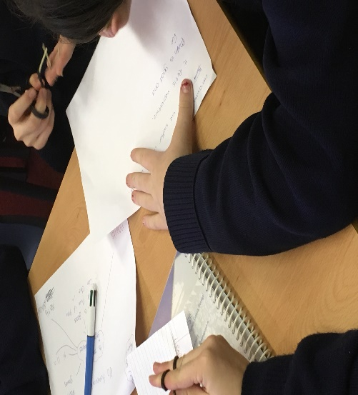
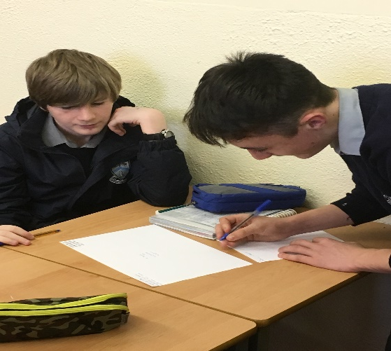
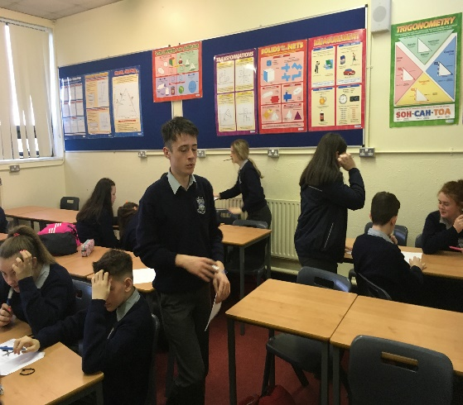

2 Transition Year Classes 1 Lesson Per Week
Students give feedback
Familiarise students with these strategies
Give teachers a opportunity to refine the methodologies
Utilise our open door policy

Slide 11
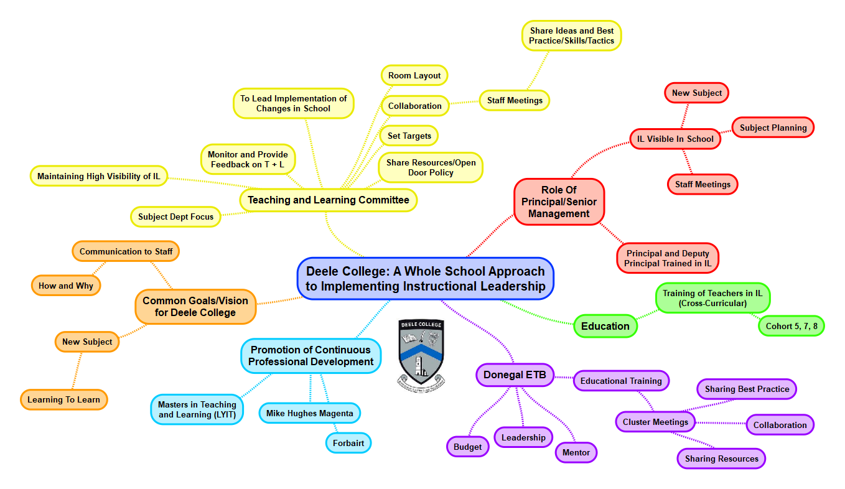

Slide 12
Implementation Of Instructional Leadership at Deele College

Slide 13
Academic Controversy Activity

Slide 14

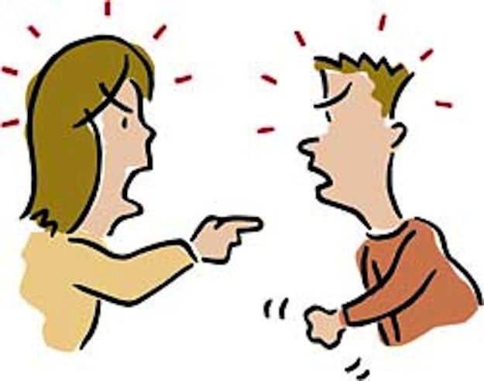
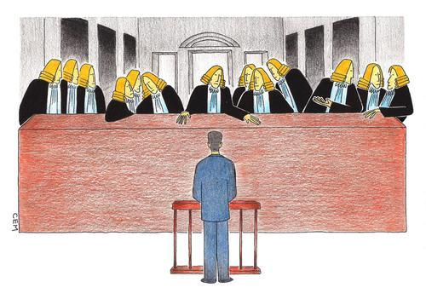





Skills required for Academic Controversy
Taking Turns
No put downs
Suspending
judgement
Actively listening
Paraphrasing
Disagreeing
in an
agreeable Way
Disagreeing
with the idea,
not person
Accepting and
extending the
ideas of others

Slide 15
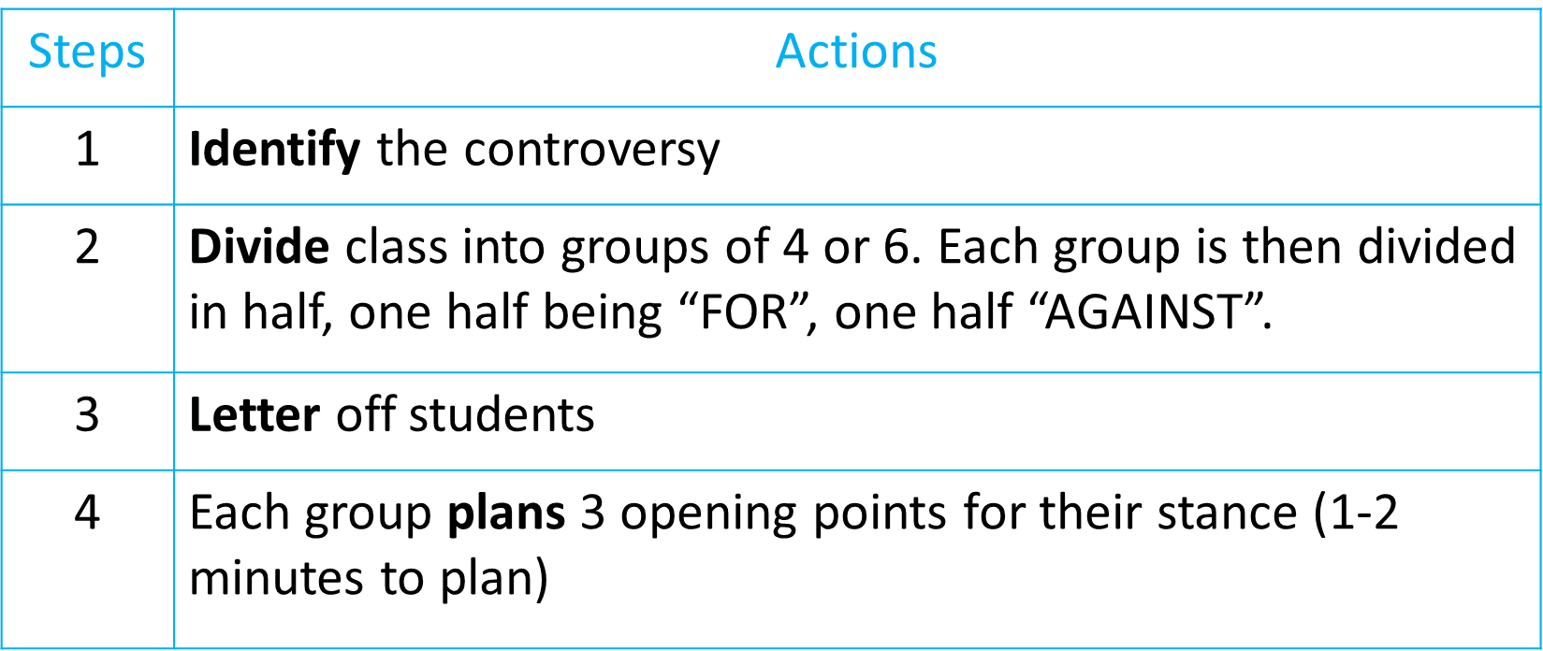
Academic Controversy

Slide 16
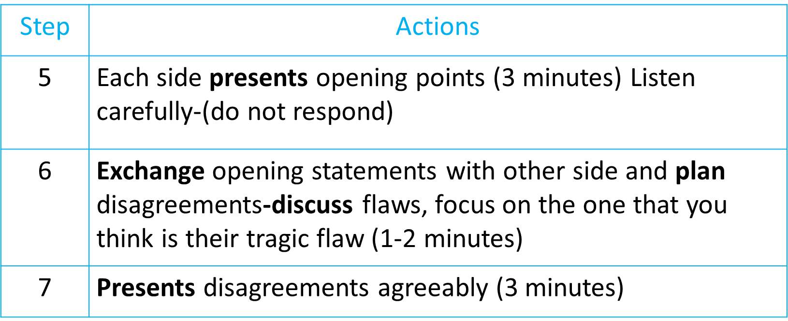
Academic Controversy

Slide 17
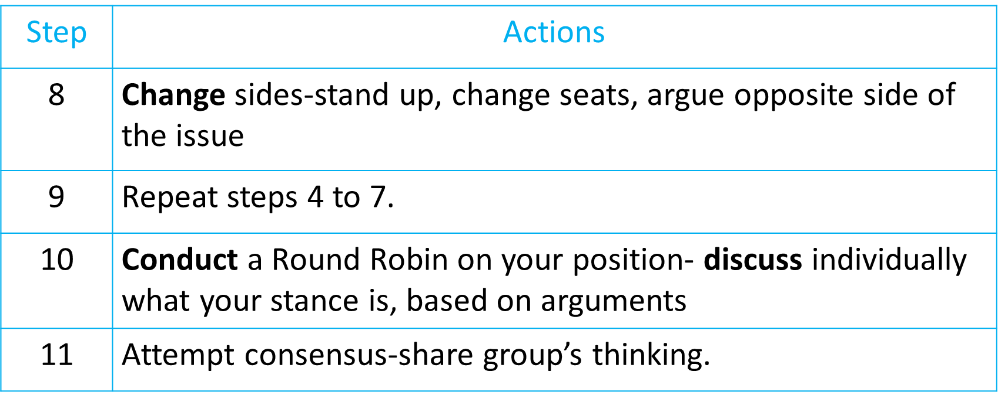
Academic Controversy

Slide 18
Jigsaw Activity

Slide 19
Teams Game Tournament Activity

Slide 20
Planning your start of year staff meeting activity.

Slide 21
Question and Answers

Slide 22

Professional Learning Community
Continue to develop and promote IL throughout the school.
Continuous professional development for our teachers.
Collaboration and sharing of best practice.
Professional dialogue to enhance Teaching, Learning and Assessment.
Review, refine, improve and involve more teachers, students and parents.

Slide 23
Revisit the Learning Outcomes
Identify a wide variety of learning and teaching methods that may be employed effectively in staff meetings to model best practice of an active classroom.
Identify effective strategies and incorporate them into problem solving timetabling issues.
Apply Instructional Leadership to recap on the key information on four key managerial issues by participating in a Teams Game Tournament.
Work as part of a team in analysing issues in a school context with your peers.
Develop a staff meeting agenda that incorporates Instructional Leadership.
Evaluate what impact Instructional Leadership as a method of engaging teachers in key school issues could have on your staff in September.

Slide 24
Reflection
Description: What happened?
Interpretation: What is most interesting, important, useful and relevant?
Outcome: What have I learned from this?

