Slide 1
Instructional Leadership
Teams Game Tournament

Slide 2
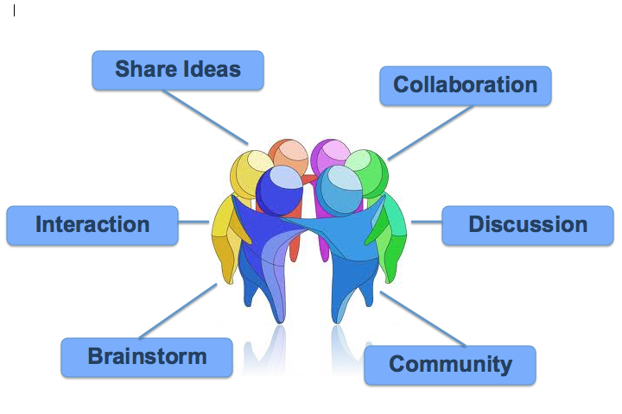
Academic Aim
To experience and play Teams Games Tournament
Collaborative Task:
  Equal Participation,
  Allocation of group,
  Play game.
Notes:
Research has shown that teacher structured groups are the most effective in group work. The other two group structures are less effective and can cause group to become a difficult task for maintaining classroom management.
Group Structures
Teacher Structured group (best structure)
Random ( not as effective)
Friendship (worst-avoid at all times)
Directions for the Presentation
Why use IL?
Aims of TGT
Outline objectives of TGT
List of instructional methods used in TGT
Give rules to TGT
Play game
Evaluation of lesson

Slide 3
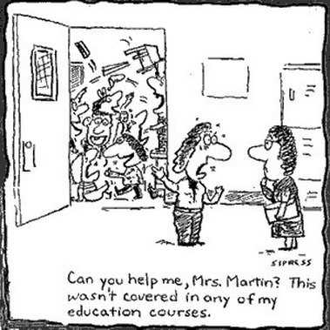
Why use IL?
Strategies, skills and tactics
Student learning
Safe environment
Educational reform
  SSE/New Junior Cycle/L&N
  & Assessment
School improvement and evaluation
Notes:
IL is an approach that can be used to maximise our effectiveness as educational practitioners. It looks for us to facilitate the learning environment and to try and remove the old practices that may have embedded in the class as what has been perceived for decades as a good education, i,e. rote learning.
The role of IL is to engage and promote effective teaching and learning that creates an environment that is positive for the teacher and the learner.
With the recent educational reforms a welcomed review of the methodologies that can be utilised in the delivery of the courses dove-tails neatly into the ethos behind IL .
Assessment, Why?
Motivation
To measure learning
To monitor, assist and learn through constructive feedback
For Teacher, Assessment can assist and improve teaching
Professional requirements, i.e, LC & JC
TGT is a for of assessment and it is assessment for learning and can be assessment as learning.

Slide 4
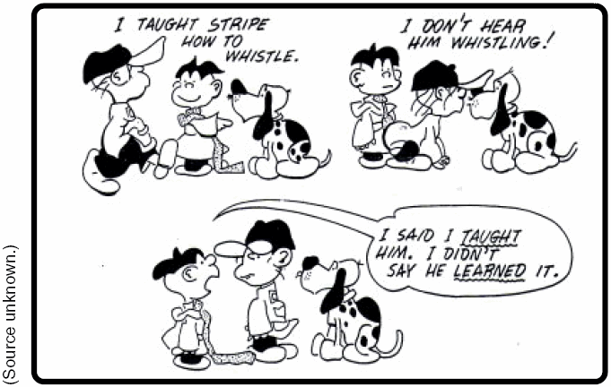
Teams Game Tournament Aims & Benefits
Co-operative learning
Social construction
Formative assessment
Literacy and numeracy
Independent Learning
Assessment for Learning
Assessment as Learning
Summative Assessment
Leaving and Junior Cert
Notes:
Co-operative learning:
Where the teacher and learners are contributing to the learning experience in the class. We as teachers want our students to be engaged with the class content and with their peers in a social setting that gives them the opportunity to develop and enhance skills that will be applicable to real-life settings, i.e. the work-place.
Independent learning:
The students take ownership of their learning and also that of their peers. This learning develops association and relives the drudgery of rote learning. It can also create a sense of purpose and students become more concerned about their attendance and this impacts on class-room management. It becomes important for all team members to be present and this can be an intrinsic motivator.
Social Construction:
A concept developed by Vygotsky and Piaget, Dewey & Skinner. IL lends itself neatly into allowing students the opportunity to engage in curriculum in a meaningful and beneficial way within a social setting, ie in school the classroom.
TGT is a good model to use to allow students from all academic ranges to be socially included in the class in terms of teaching and learning.
Formative Assessment:
TGT is an excellent way to use “Assessment for Learning” (AfL), More recently the new mode of formative assessment developed by Lorna Earls is “Assessment As Learning”. In this approach student write their own assessment. In context to TGT, get the students to generate a few questions (they also most supply the answers and if needed the teacher can elaborate) each. These then are used as the TGT questions. In a way they can also be used as Summative Assessment in “Assessment of Learning” (AoL) in a class test or monthly assessment.
LC and JC are summative assessment. As students will be sitting this form of assessment, we as teachers need to provide them the opportunity to practice this form of assessment. TGT can be used as a revision before taking a summative assessment, i.e. Class test, Christmas/Summer Exam,
Literacy and Numeracy:
Reading of questions, the use of keywords, using a deck of cards, keeping score
TGT was developed in the 1960s by deVries. The foundation of it is based on assessment for learning, in respect of the number of questions and the allocation of points that is open for interpretation by the teacher. It really is open for the teacher to use a system the think will be best for their students and teacher know their students best.
Independent Learning-Self directed learning

Slide 5


Teams Game Tournament - Objectives
Academic achievement
Motivation
Peer tutoring
Real life application
Notes:
Motivation:
TGT can be a excellent way to motivate students but again it will highly depend on the small complex structured groups. It is inevitable that competition establishes itself within the class as students play against each other.
Motivation: Intrinsic (Student wanting to do well) V Extrinsic (A prize for getting the best score)
In IL a prize should never be for the benefit of an individual, it should be for the class, or at the very least the group is rewarded as recognition of their effort.
Peer-Tutoring:
As the game processes and the fact that students have a partner for the game means students have the opportunity to learn from each other. They are not alone in answering the question they have the support of their partner. This creates a safety for the learner and it eliminates the fear of failure and embarrassment of being unsure or not knowing that can often have a negative ripple effect in a open classroom setting.
Self-efficacy:
This is developing students elf-esteem and creating a “can-do” attitude to their own learning. Students with a high self-efficacy are open to changes and are more willing to investigate the unknown as the fear of failure is greatly reduced.

Slide 6
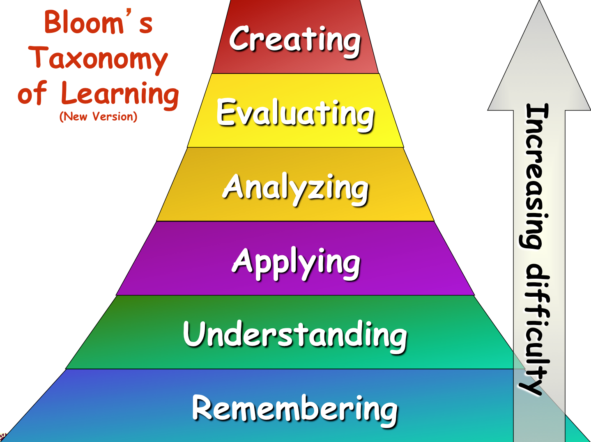
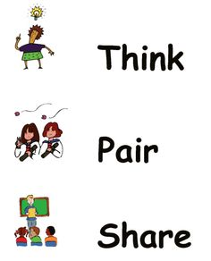

Teams Game Tournament –Instructional Methods
Notes:
Blooms Taxonomy is an instructional organiser. It is organised in low-order to higher order thinking questions. The areas of Blooms are Remembering (Recall), Understanding (Comprehension), Applying (Knowledge), Analysis, Evaluating (Application) and Creating (Synthesis). It is important that we use Blooms to maximise the effectiveness of our questions.
Blooms is integral to framing questions
Framing questions: is an instructional Skill. Questions should be used to enhance and check learning. Use questions appropriately to suit the student.
Wait Time is an instructional skill. It is recommended that you give a learner a minimum of 3 seconds.
Think-Pair-Share: Is an instructional tactic. Put a question out there, give students the chance to think about what you asked, then get them to confer with their partner and then inform them that you will select someone to answer. This is important as you are informing them that they all need to have an answer ready if they didn’t know initially.

Slide 7
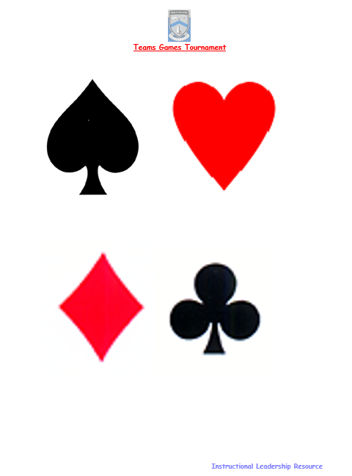
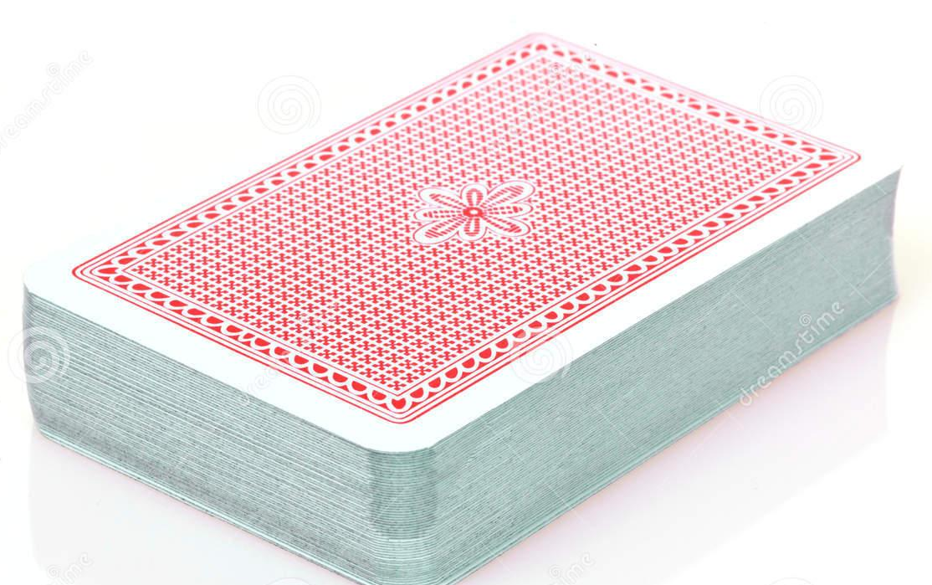
Materials Required
A deck of cards per two teams
Question Sheet
Answer Sheet
Score Sheet per team

Slide 8
Teams Game Tournament
The Rules
There are four people in the group
Every group is given a pack of playing cards (remove the Joker from each pack of cards)
In each group, create two teams of two.
Call the first team: Team A and the second team: Team B or create team names
Shuffle the cards.

Slide 9
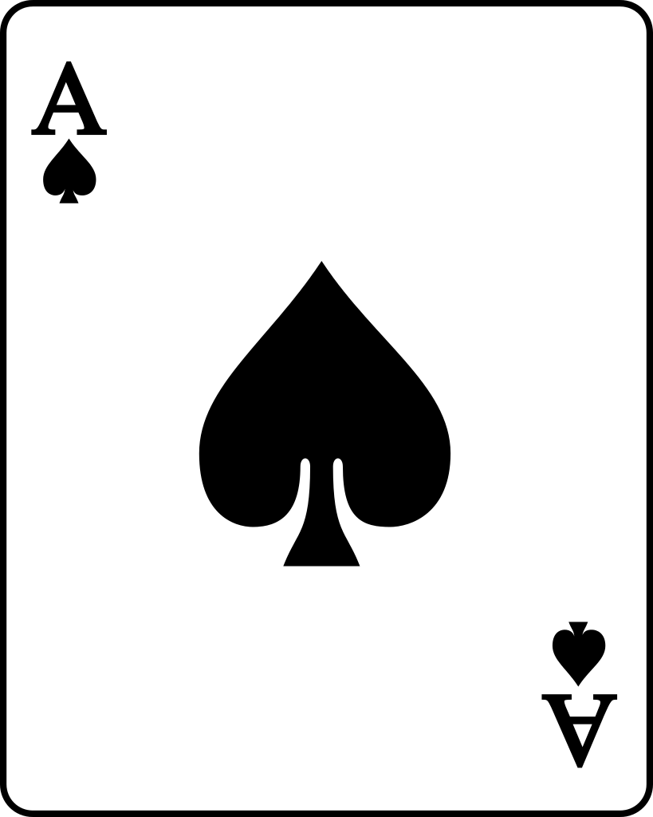
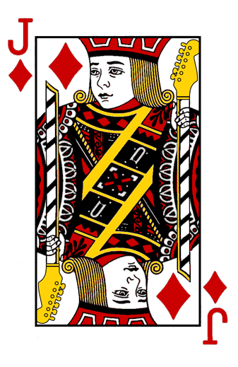
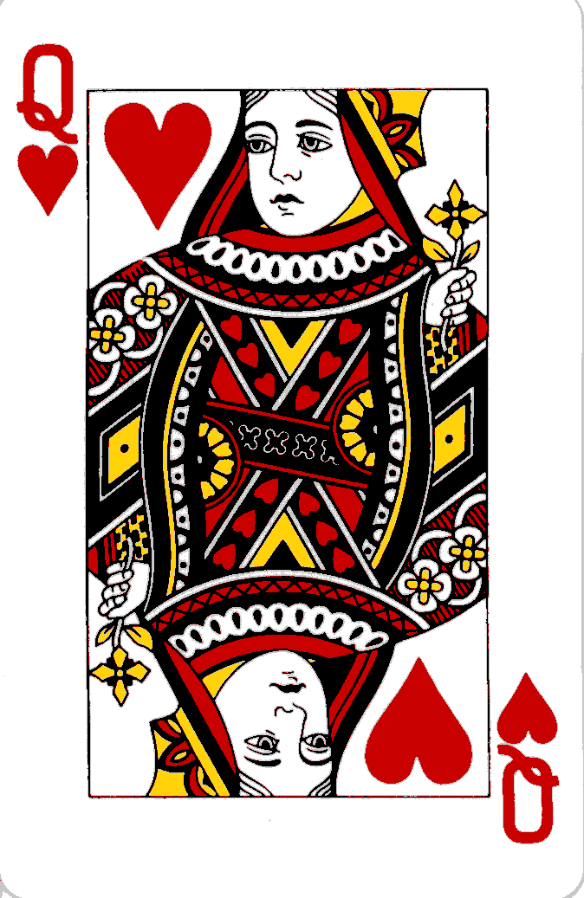
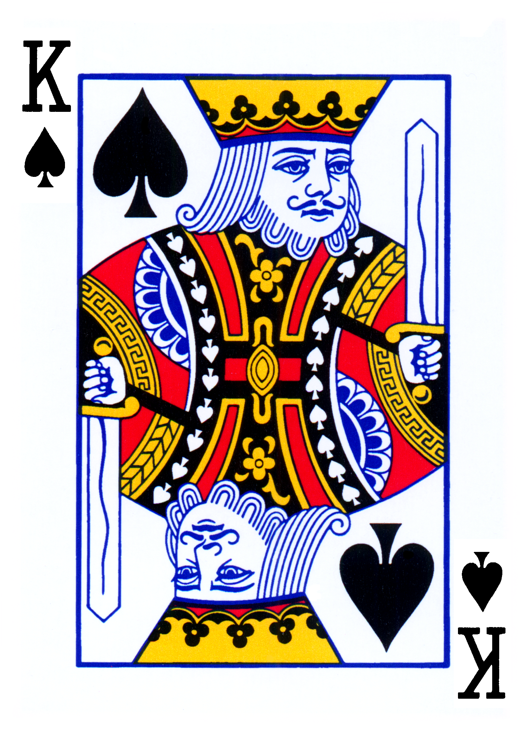
Teams Game Tournament
The Rules
One person from Team A pulls a card from the pack.
Team A reads aloud the corresponding question on the question sheet.
(Note: 1 = Ace)
If Team A give the correct answer, they receive 2 marks, which is written on their score sheet (if there are two parts, give 1 mark for each part) Team B has the answer sheet. Team A notes Team B’s score and visa versa.
The Card pulled should be placed to one side and not put back into the pack.

Slide 10

Teams Game Tournament
If the care you have pulled is a Queen, you get 3 bonus points for a correct answer.
If it is the Queen of Hearts, you get five bonus points for a correct answer.

